Slide 1
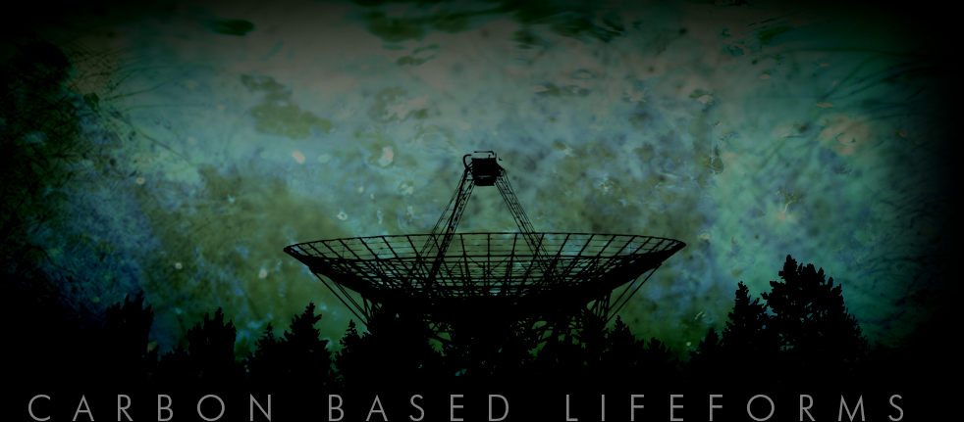

EIROP Action Before the biological tragedy
Shehan, Sarala and shyamali
October 2020

Slide 2
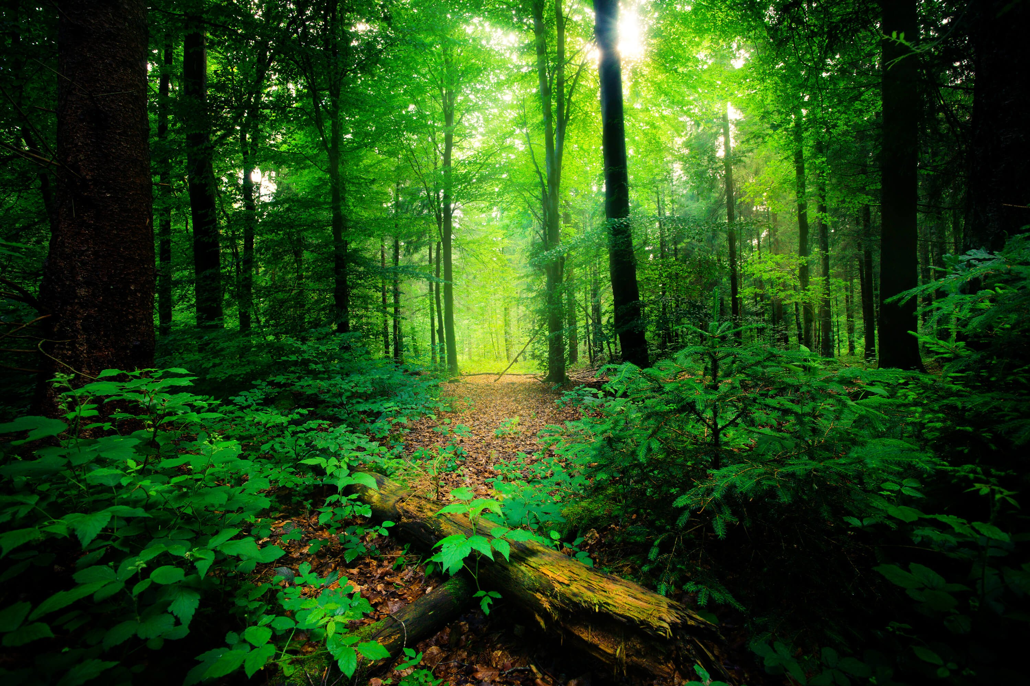
THE CHALLENGE: Scanning for Lifeforms Our challenge addresses a pressing global need to track change in biological diversity, which is threatened by human-driven environmental change. Use space agency data to develop innovative ways to detect biological diversity on Earth, track and predict changes over time, and communicate that information to scientists and society.

Slide 3
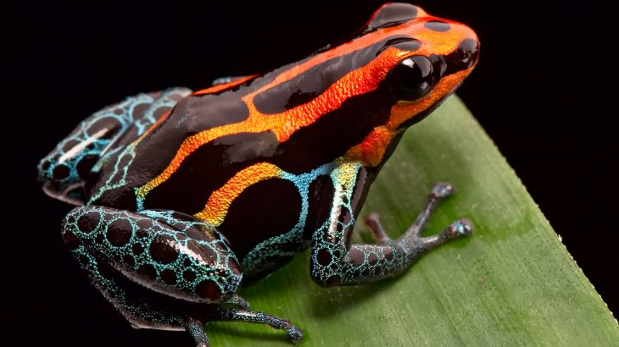
The problem:
Human activities (i.e: Travelling, Tourism] affects the Amphibians diversity in a large scale
OUR CHALLANGE
Our challenge is to observe how the travelling and tourism affects on the bio diversity of Amphibians by tracking and predicting changes over time, and communicate that information to scientists and society. Simply our challenge has two methodologies.

Slide 4
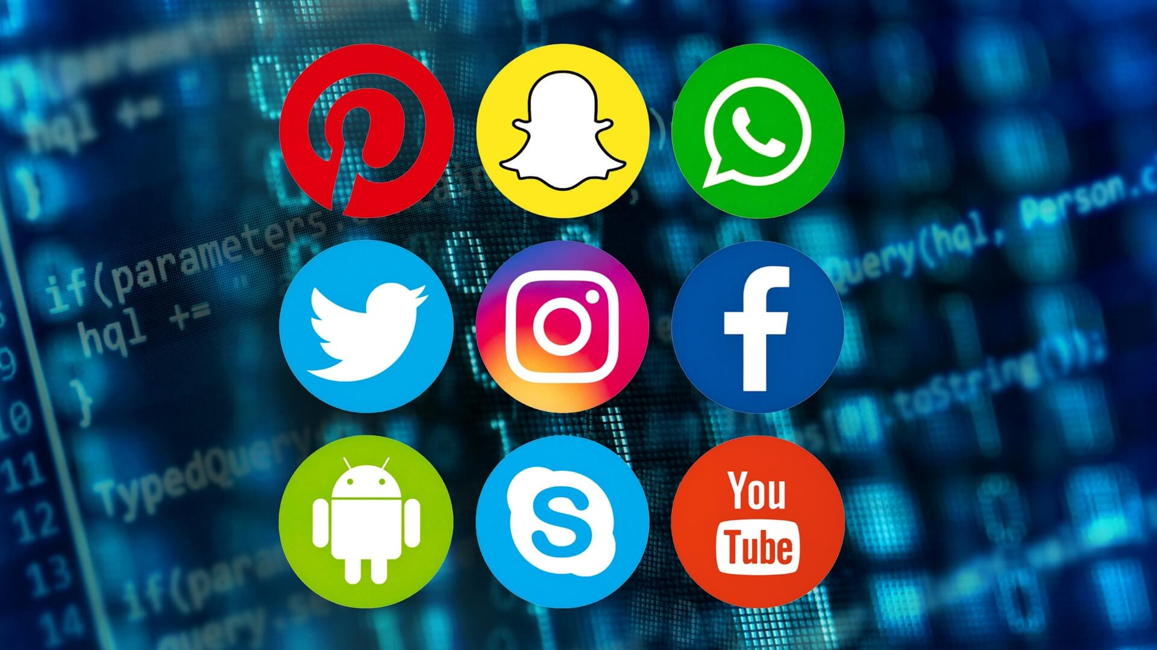
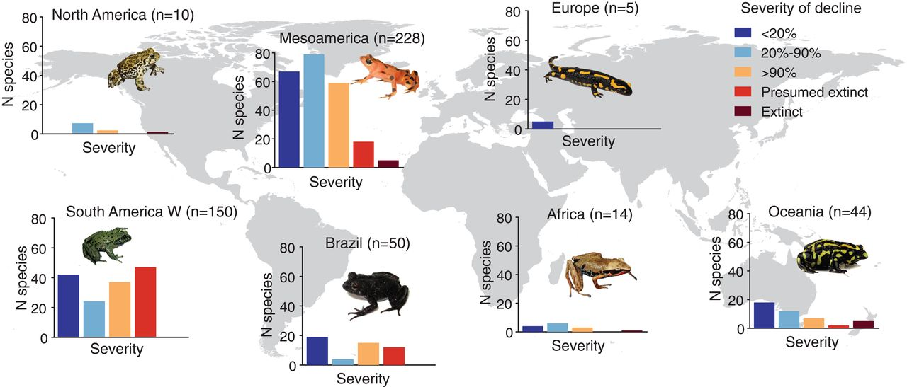
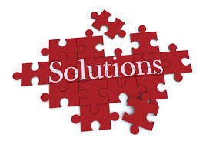
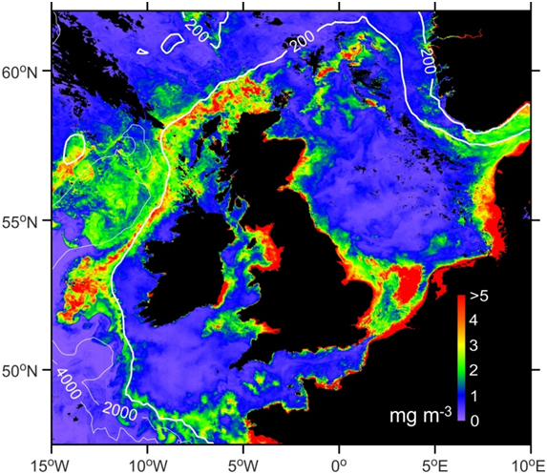
Capturing the tourism affects on the amphibians data processing
(Amphibians)
Get information about biodiversity
Occur if cases are un detected
Environment and climate data
Solution and reports data
Social media and public data

Slide 5
Solution: Advanced tracking and predicting system
The data are taken from global satellites (NASA,JAXA satellite data) data and the considering environmental data are filtering among them. Then compare satellite data and social media or public data with each other and get statistical analyzed data as output about
to where? When? and how? the travelling and tourism trends are creating and inform the authorities to take pre actions to protect amphibian’s habitats

Slide 6
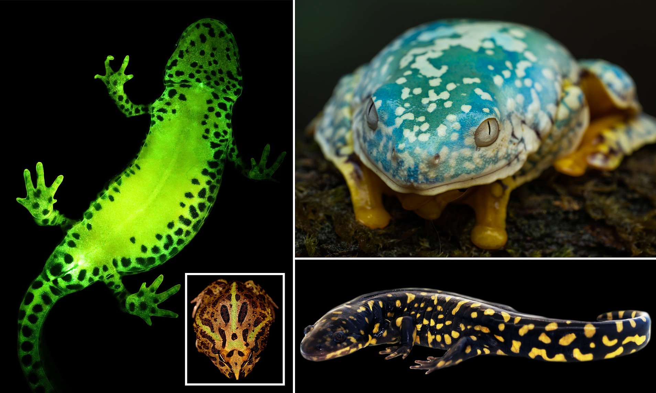
Data Driven portal
Descriptive
Surface and visualize existing amphibians diversity
Predictive
Establish contributing factors and project
Prescriptive
Provide guidance on areas and information

Slide 7
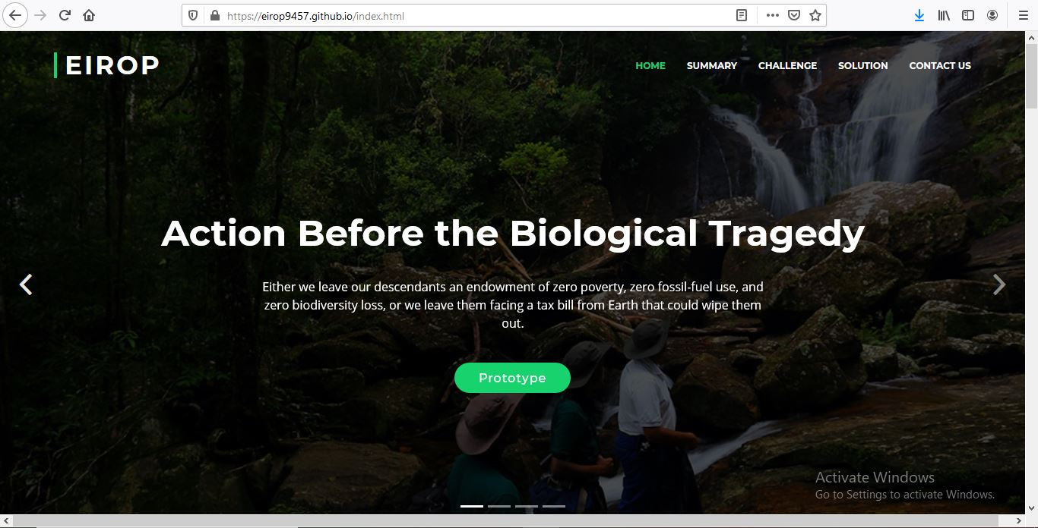
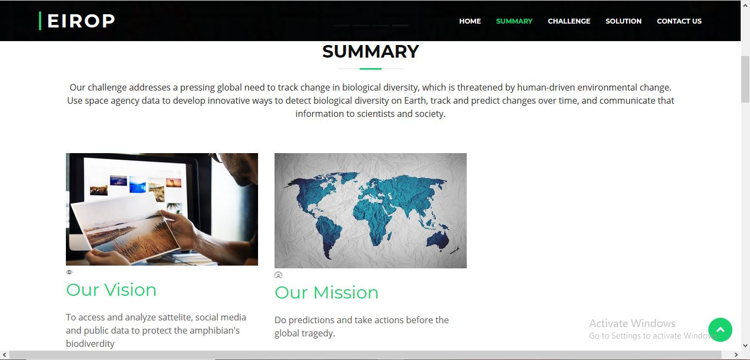
Making data accessible

Slide 8
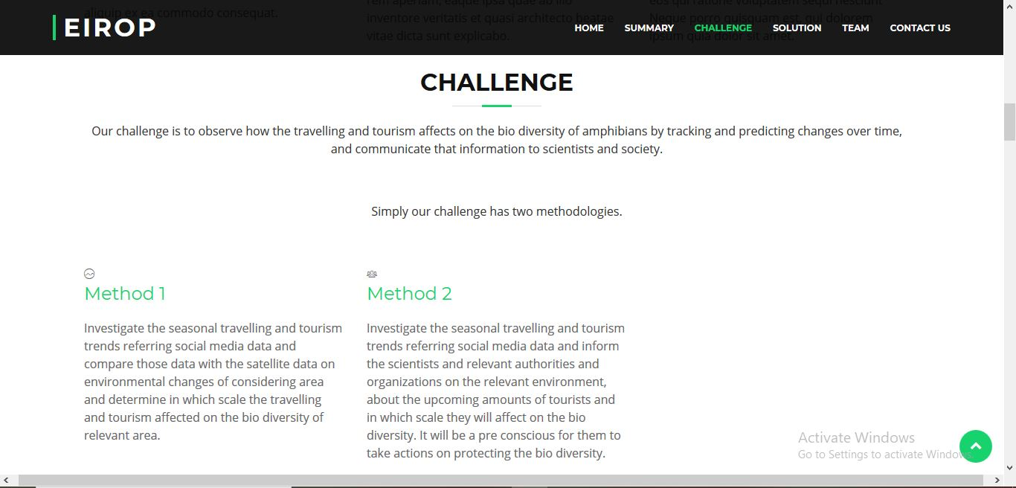
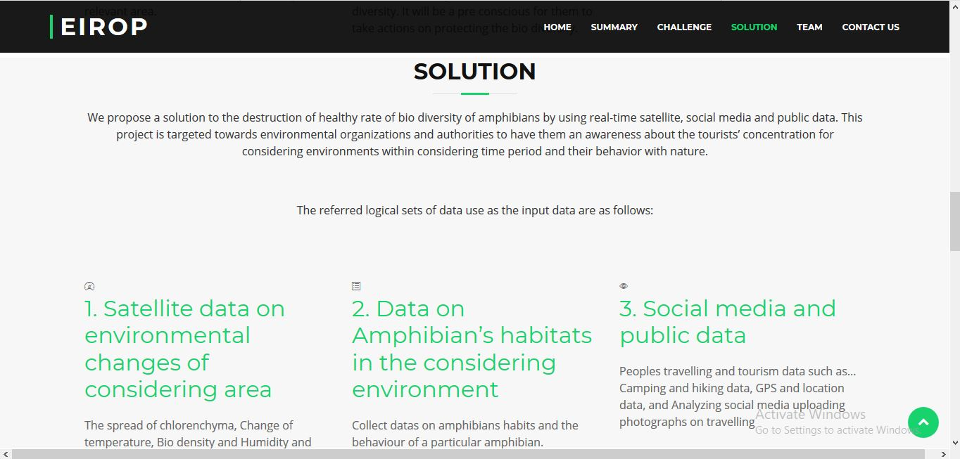
Making data accessible

Slide 9
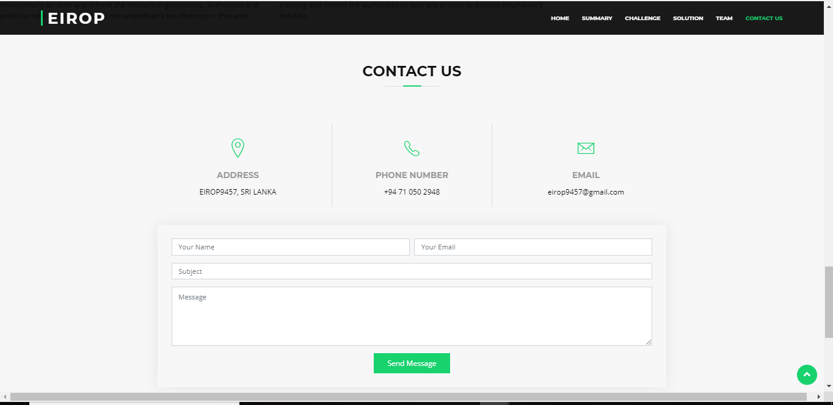
Making data accessible

Slide 10
Beneficiaries
The parties who receive benefits from our project
Scientists
Environmental organizations and authorities
medias

Slide 11
Future steps
To filter the convenient data from global data and satellite, statistical analyzing and machine learning.
Develop to the web application level
Develop to the mobile app level
Develop to a hardware level
Extend the users range
Extend the considering environments to a global level.
Extend the applicable biological categories

Slide 12
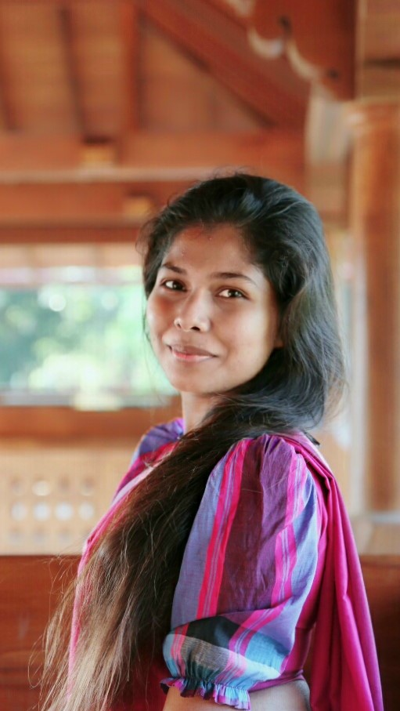

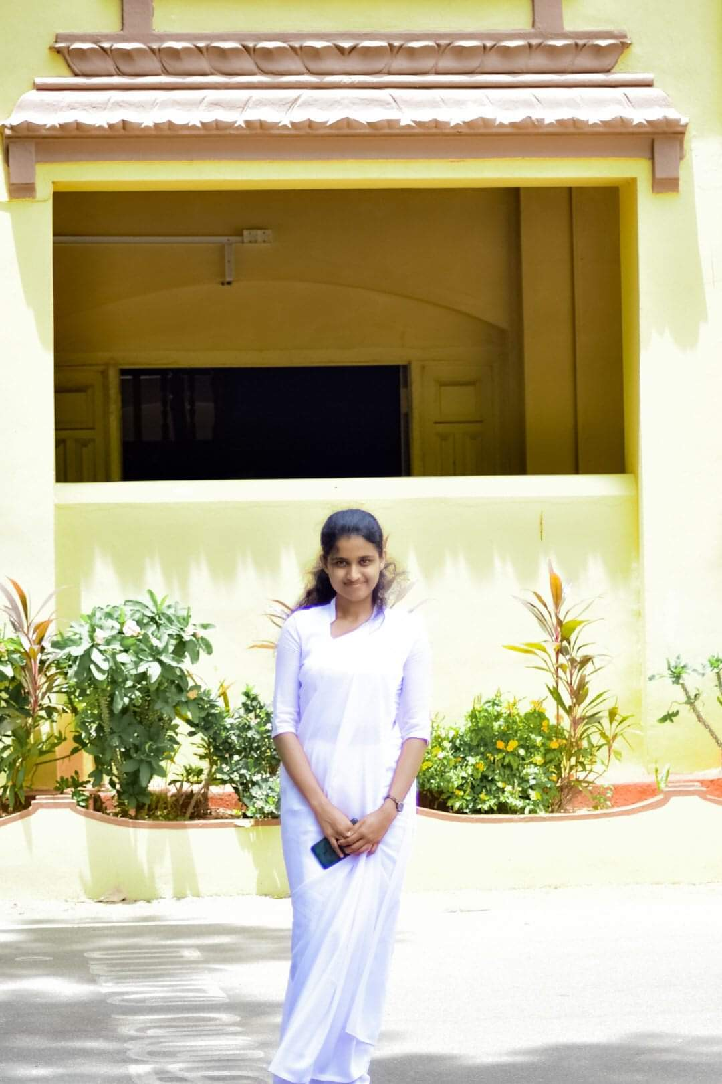
Team EIROP
Sarala Shalini
Chamod Shehan
Shyamali Ekanayaka

Slide 13

Exploring Infinity Realms of Possibility
Thank you

